Slide 1
KSI
DATA
Research
Module #02
Understanding the list of system Aggregation functions
When and how group by statement is going to be used.
When and how Where and Having clause used in Aggregations.
Homework #3 for Aggregation.
What are Primary key and Foreign Key and their differences
Concept of Entity relational diagram (ERD)
Type of Relationship among tables using Key
What are a join-in table and Different types of Join databases?
Learned types of join by using emp1 and dept1 tables.
Homework #4 Join tables of Employees and Departments.
Learned types of join by using Employees and Departments tables
Fetch data from the HRSchma using 7 tables.
Create a database diagram from HRSchema and saved it
Homework #5 understand left and right join.
Homework #6 understand join and filter.

Slide 2
Grouping and Aggregating data
Under the Programmability system functions are listed
Such as:
COUNT, MAX, MIN, SUM, and AVG
----- Sum(), Max(), Min(), count(), avg() ----
to group the result-set by one or more columns.
Create table GroupData
(
id int,
name varchar(200),
salary money,
Gender char(1)
)
Select * from GroupData
The GROUP BY statement is used with aggregate functions
( the columns does not participate in aggregation go under group by clause)
insert into GroupData values(1, 'sara', 3000, 'F')
insert into GroupData values(1, 'sara', 3000, 'F')
insert into GroupData values(1, 'sara', 3000, 'F')
insert into GroupData values(2, 'sara', 1000, 'F')
insert into GroupData values(2, 'sara', 1000, ‘M')
NO Group by Statement is required:
Select Sum(salary) sum_salary from employees
Select min(salary) min_salary from employees
Select max(salary) max_salary from employees
Select count(salary) count_salary from employees
Select avg(salary) avg_salary from employees
SO The GROUP BY statement groups rows
that have the same values
Where Clause is used to filter rows before aggregation. But Having clause
is used to filter groups after aggregations.

Slide 3
Grouping and Aggregating data
Grouping salary data for all employee
table columns
Select Job_id, sum(salary) as totol_salary
from employees
Where salary > 12000
group by Job_id
Having sum(salary) > 13000.00
order by sum(salary) Desc
--1) Display manager ID and number of employees managed by the manager.
--2) How many employees who are working in each department in the organization
--3) Display number of employees joined after 15th of the month.
--4) List all the department ids having at least four employees.
-- 5) Display average salary of employees in each department
---6) Display job ID, number of employees, sum of salary, and difference between highest salary and lowest salary of the employees of the job.
---7) Display job ID for jobs with average salary more than 10000.
---8) Display years in which more than 10 employees joined.
SELECT [employee_id]
,[first_name]
,[last_name]
,[email]
,[phone_number]
,[hire_date]
,[job_id]
SUM([salary]) totsalary
,[commission_pct]
,[manager_id]
,[department_id]
FROM [HRSchema].[dbo].[employees]
Group by
SELECT [employee_id]
,[first_name]
,[last_name]
,[email]
,[phone_number]
,[hire_date]
,[job_id]
,[commission_pct]
,[manager_id]
,[department_id]
Home Work #3
Syntax for the Group Functions.
SELECT <column_name> FROM <table_name> WHERE <condition> --Eliminate data before grouping GROUP BY <column_name>
HAVING <column_name> Eliminate group after aggregate ORDER BY <column_name>
Display how many employees working
departments wise?
How many total employees working? = 107
How many departments name in department =27
How may departments assign to emp = 11
How many student do not have department = 1
How many department do not have employees = 16
Find out numbers of Customers from the same country?
Find out numbers of employees working in the IT dept?

Slide 4

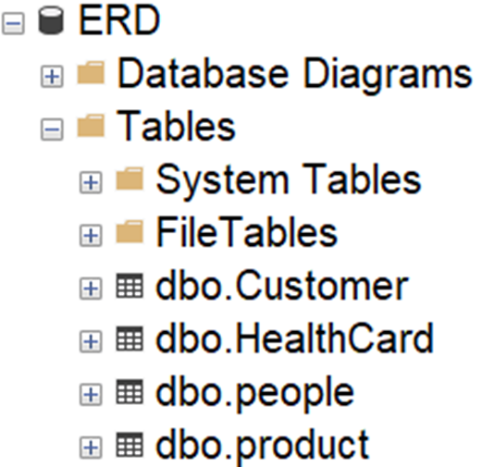
Primary key and Foreign key
Learn also identity
Primary key and Foreign key Relationship
Primary key(Pk) constraint uniquely identifies each record in a table. Primary key must contain unique values, and can not contain NULL values. Primary key in a table not mandatory but recommended. One table can have one primary key only.
Foreign Key (Fk) is a column or set of columns in one table that reference the primary key column in another table. Another word, Foreign key is a column or combination of columns that is used to establish and enforce a link between the data in two tables.
Create table emp1
CREATE TABLE [dbo].[emp1]
(
[empno] [int] NOT NULL Primary key,
[ename] [varchar](50) NULL,
[sal] [int] NULL,
[deptno] [int] NULL
)
Create table dept1
CREATE TABLE [dbo].[dept1]
(
[deptno] [int] NOT NULL Primary key,
[dname] [varchar](14) NULL,
[loc] [varchar](13) NULL,
)
Insert data into emp1
insert into emp1 values(100,'Smith',800,1)
insert into emp1 values(101,'Alen',1600,2)
insert into emp1 values(102,'Ward',1250,2)
insert into emp1 values(103,'Jones',600,NULL)
Insert data into dept1
insert into dept1 values(1,'Accounting','New York')
insert into dept1 values(2,'Research','Dallas')
insert into dept1 values(3,'Sales','Chicago')
insert into dept1 values(4,'Operations','Boston')

Slide 5
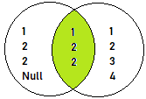

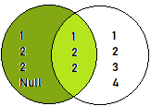
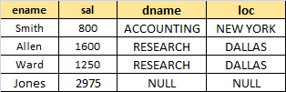
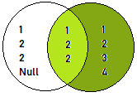
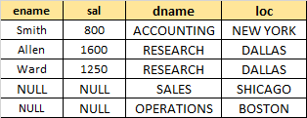
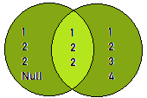
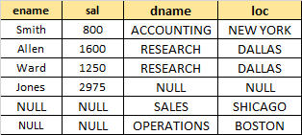
Different types of Join
What is Join in SQL Server?
Join is combined data from two or more related table.
Those tables are connected through primary key and
Foreign key constraint.
Create table emp1
Inner Join: Combined only the matching rows among the tables.
CREATE TABLE [dbo].[emp1]
(
[empno] [int] NOT NULL Primary key,
[ename] [varchar](50) NULL,
[sal] [int] NULL,
[deptno] [int] NULL
)
Download employee table
And Department table
Create all the join you have
learn
Home Work #4
Create table dept1
CREATE TABLE [dbo].[dept1]
(
[deptno] [int] NOT NULL Primary key,
[dname] [varchar](14) NULL,
[loc] [varchar](13) NULL,
)
Left Join: Returns all the matching rows , plus non matching rows form the left table.
Insert data into emp1
insert into emp1 values(100,'Smith',800,1)
insert into emp1 values(101,'Alen',1600,2)
insert into emp1 values(102,'Ward',1250,2)
insert into emp1 values(103,'Jones',600,NULL)
Right Join: Returns all the matching rows , plus non matching rows form the right table.
Insert data into dept1
insert into dept1 values(1,'Accounting','New York')
insert into dept1 values(2,'Research','Dallas')
insert into dept1 values(3,'Sales','Chicago')
insert into dept1 values(4,'Operations','Boston')
Full Join: Returns all the matching rows, plus non matching rows from the both tables

Slide 6
Entity Relational Diagram(ERD)
Concept of Related table – ERD
Tables are related based on Keys
Most common relationship between Primary key
and Foreign keys
There are three types of relationship among tables.
One to one relationship ( 1 to 1)
One to many relationship (1 to m)
Many to many relationship (m to m)
Example of three types of relationship among tables.
One person can have one health card (1 to 1)
One customer many order, one category many products
One department many employees ( 1 to m)
Students can have many courses and courses can have many students (m to m) , need 3rd table, call bridge table
Primary key and Foreign key Relationship
Primary key(Pk) constraint uniquely identifies each record in a table. Primary key must contain unique values, and can not contain NULL values. Primary key in a table not mandatory but recommended. One table can have one primary key only.
Foreign Key (Fk) is a column or set of columns in one table that reference the primary key column in another table. Another word, Foreign key is a column or combination of columns that is used to establish and enforce a link between the data in two tables.
See the constrain with
Practically

Slide 7
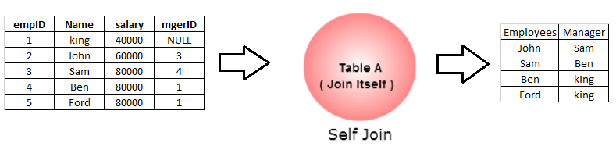
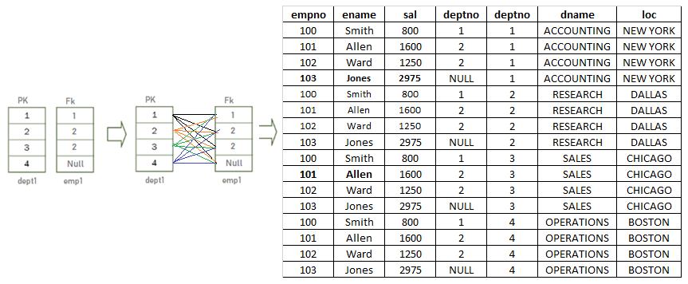
Different Join in SQL Server
---SELF-JOIN
---Create emp-manager relation table for self-join
Create table manager
( empID Int
, Name varchar(20)
,salary money
,mgerID int
)
Select * from manager
---Insert data into a emp-manager table.
insert into manager values(1, 'king', 40000, NULL)
insert into manager values(2, 'John', 60000, 3)
insert into manager values(3, 'Sam', 80000, 4)
insert into manager values(4, 'Ben', 80000, 1)
insert into manager values(5, 'Ford', 80000, 1)
-----Self Inner Join
select e.name as Employees, m.name as Manager
from manager e
inner join manager m
on m.empID = e.mgerID
---- Left Join
select e.name as Employees, m.name as Manager
from manager e
left join manager m
on m.empID = e.mgerID
Self-Join : Self join is a regular join, but the table is joined with itself
Cross Join: Produces the Cartesian product of the 2 tables involved in the join. Both emp1 and dept1 tables have 4 rows. So cross join produces 16 rows.

Slide 8
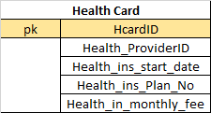
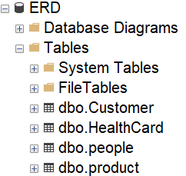
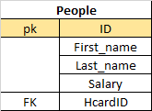
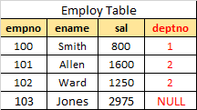
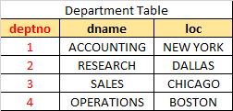
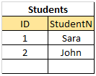
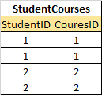


Entity Relational Diagram(ERD)
One to one relationship
1
1
One to many relationship
1
m
Many to many relationship
Not acceptable
1
1
m
m
pk
pk
Fk
Fk

Slide 9
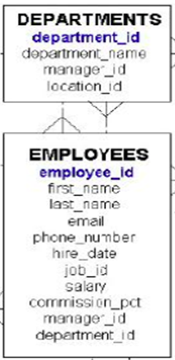
Fetching data from Multiple tables, HR Schema
Write the following queries(Querying two Tables)
--1) Fetch first_name, last_name, and their department name and location_ID.
--2) Write a query and display the Employee's info who does not have department_name.
--3) Display those departments’ names that have not yet been allocated for the employees.
--4) Write a query and display the Employee who does not have department_name. and, those departments’ names have not yet been allocated for the employees.
Home Work #5

Slide 10
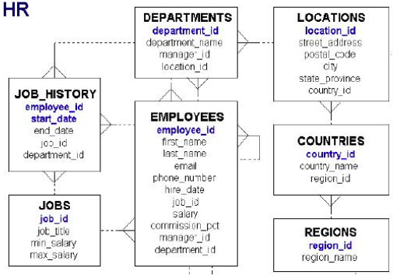
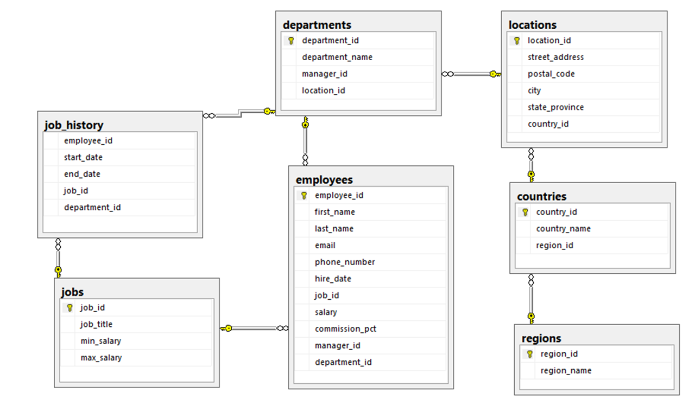
Joining and Fetching data from Multiple tables, HR Schema (EDR)
Draw Database
Diagram_0 HR Schema
Select last name, salary, department name, job title,
End date, city, country name, Region name from HR schema.
Can you join table without primary key?
Create Primary key, foreign key in a EMP and DEPT table ?
And show their constrained.

Slide 11
Write a query displaying the First Name, Last Name, and their regions from
HR schema Database, Show only those people living in America, converted
first name in upper case and last name in lower case
Display the country name, city, and number of departments where the department
has more than 5 employees.
Find out the number of employee's duplicate last names who are living in
Europe
Fetch those employees who are join after 1998 and living in the United Kingdom
Fetch those employees whose employment was between 1997 to 1999
Home Work # 6

